Slide 1
Autonomous Industrial AI
Dr. Sudip Chakraborty

Slide 2
Block Diagram

Slide 3


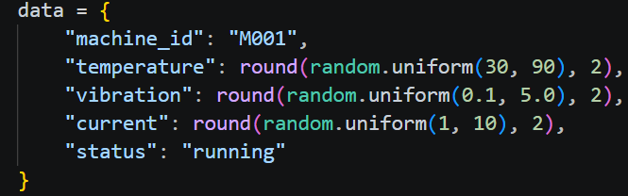
Autonomous Industrial AI
VPS
Shared Data
Dashboard
Operational Data
MQTT Broker
PDF
Excel
Content Read Agent
MQTT Subscriber
Fault Agent
Email
mqtt_subscriber.py
Database
Factory
MQTT Publisher
Vision Agent
Supervisor
Agent
MQTT Publisher
Edge Server
Voice Agent
mqtt_publisher.py
N1
N2
N3
M1
M2
M3

Slide 4
AGENT
Communication
Agent
Chat Interface
Vision Agent
Voice Agent
Digital Twin
Sensor
Agent
Edge AI
Supervisor
Agent
Edge Server
Agent
Control Agent
Sensor Agent
Maintenance
Agent

Slide 5
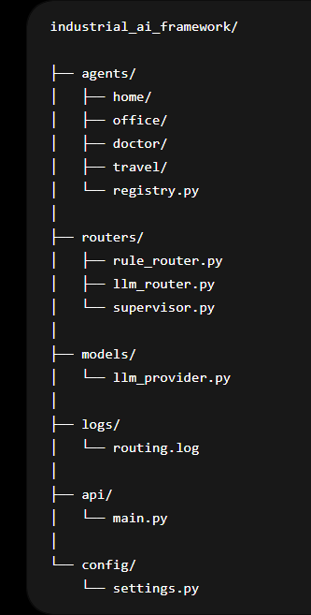
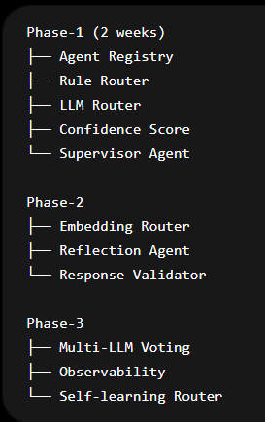
User Query Routing

Slide 6
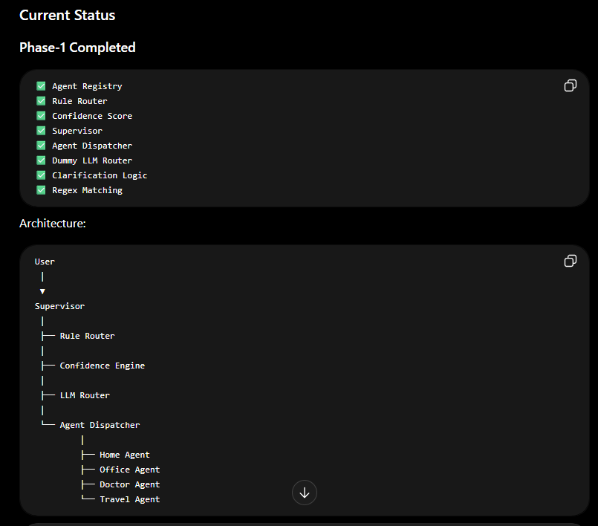

Slide 7
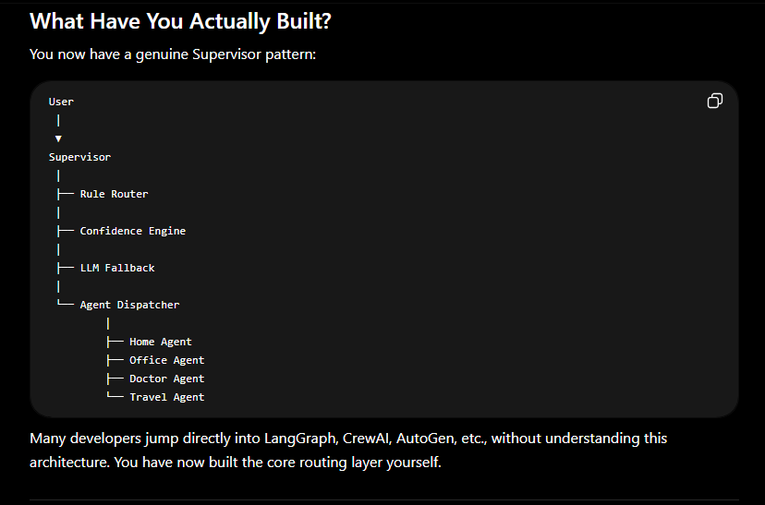

Slide 8
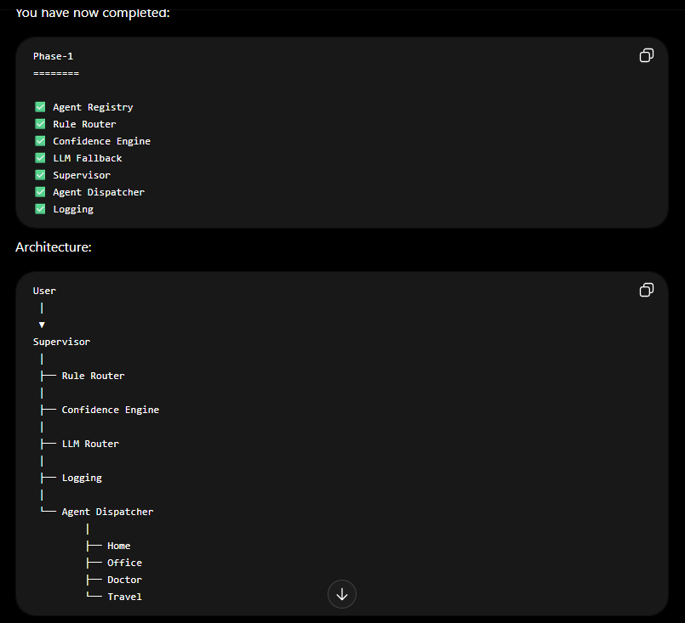

Slide 9
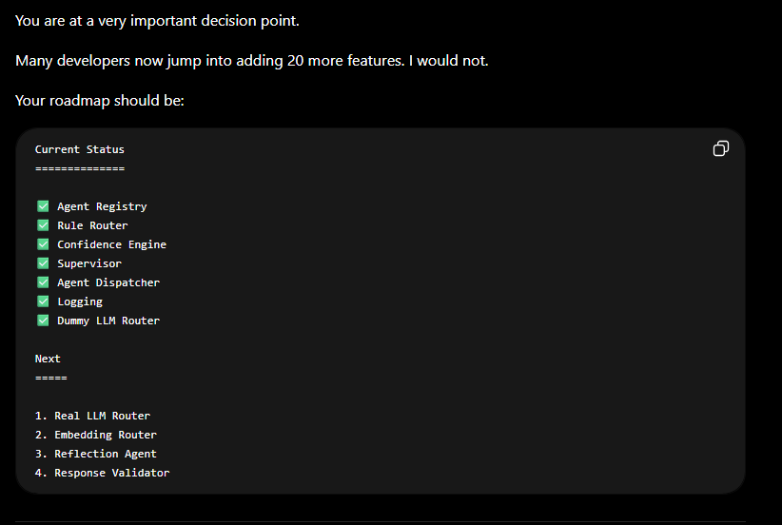

Slide 10
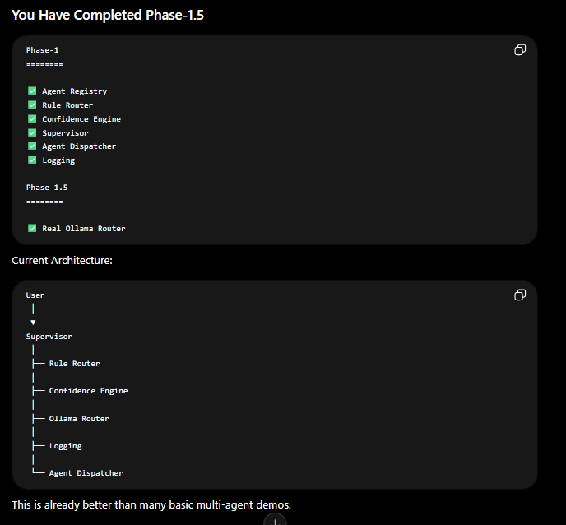

Slide 11
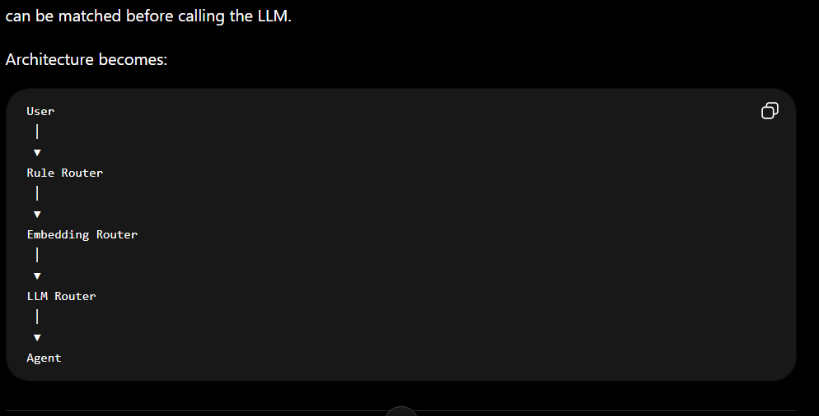

Slide 12
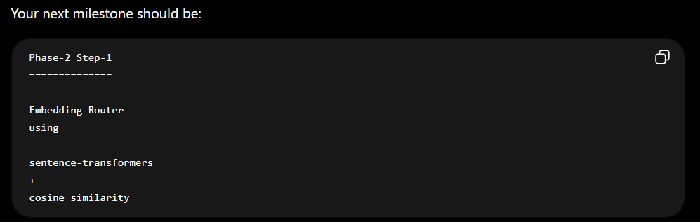

Slide 13
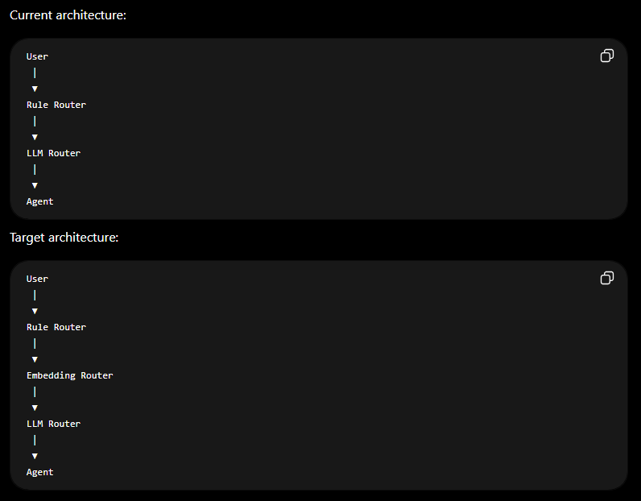

Slide 14
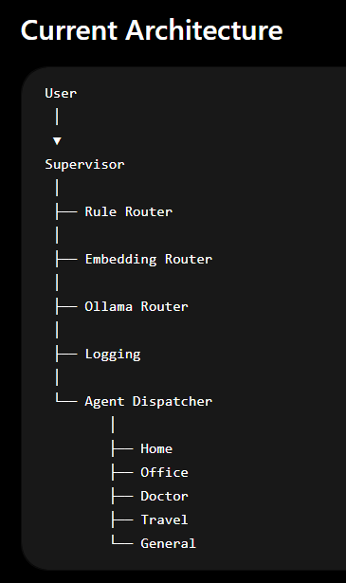
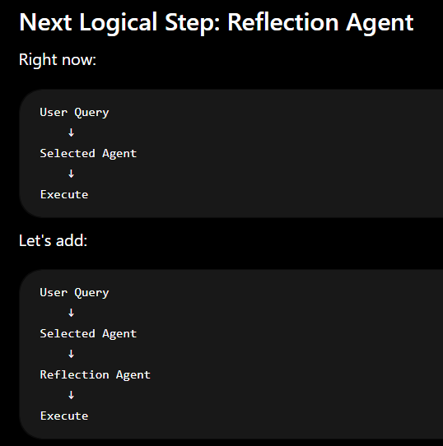
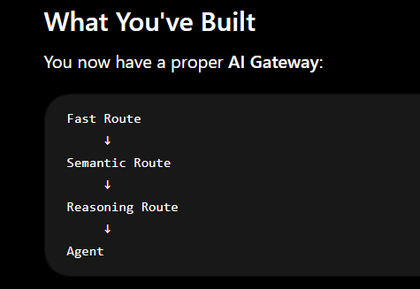

Slide 15
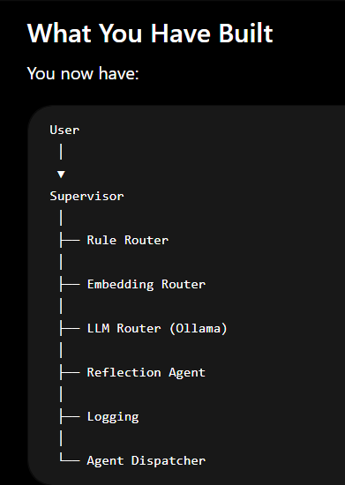
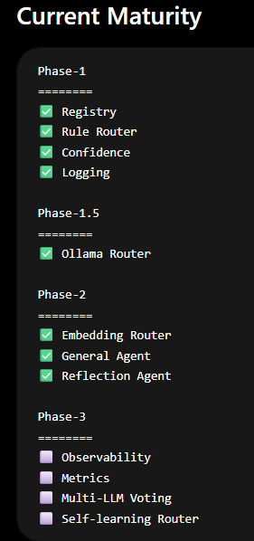
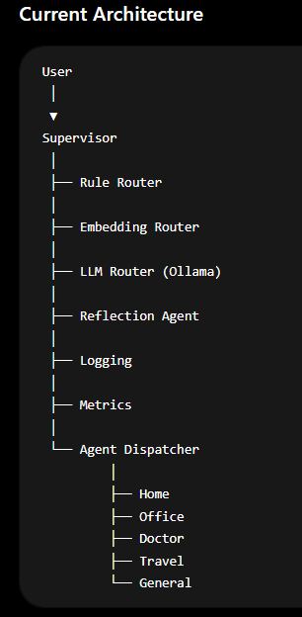

Slide 16
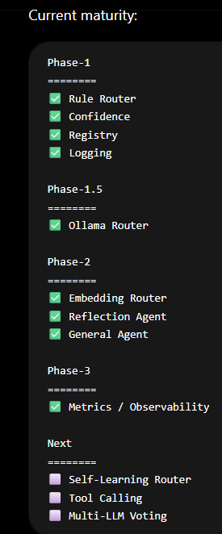
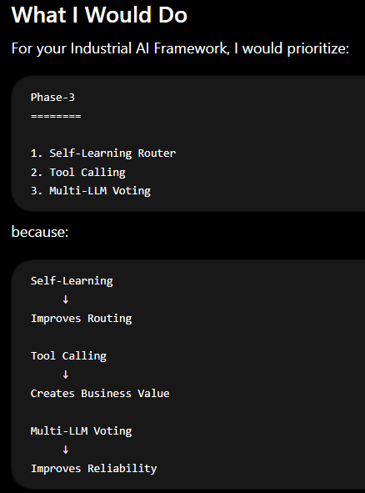
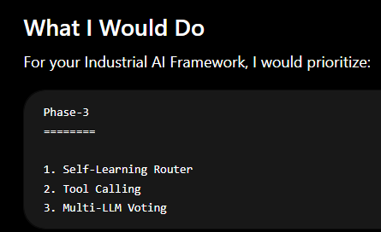

Slide 17
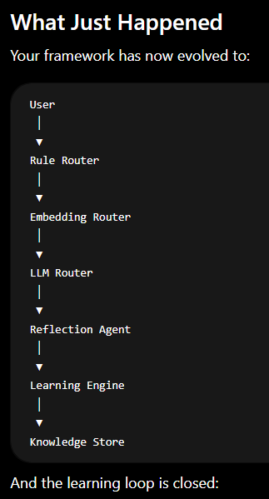
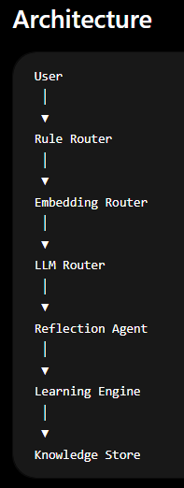
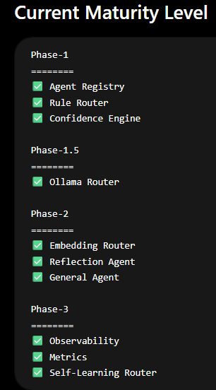
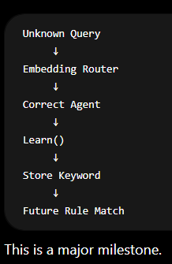

Slide 18
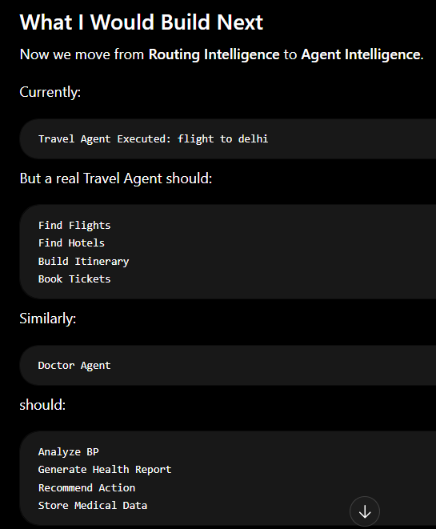

Slide 19
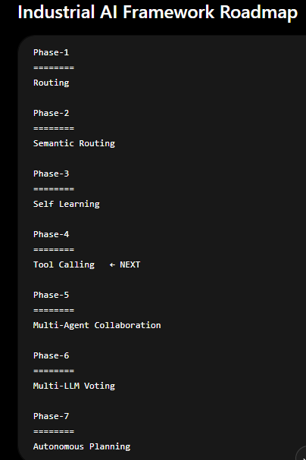

Slide 20
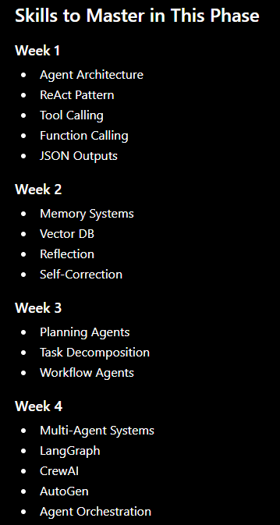
now we will start Routing Intelligence to Agent Intelligence.

Slide 21
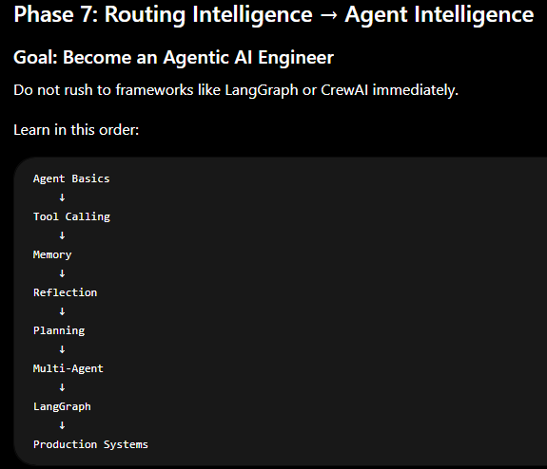
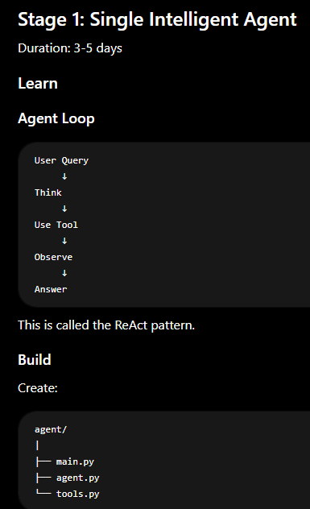

Slide 22
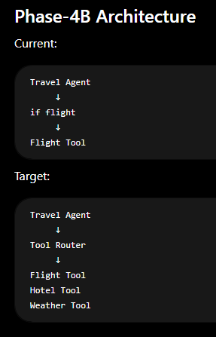
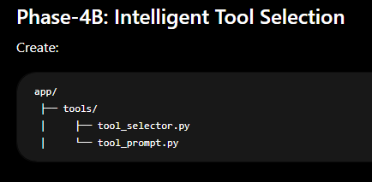
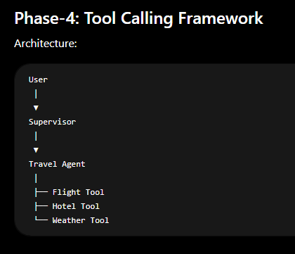
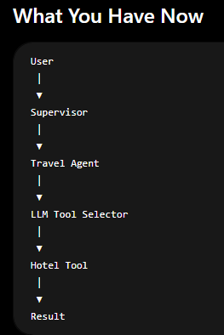

Slide 23
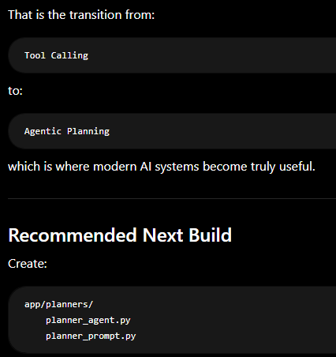
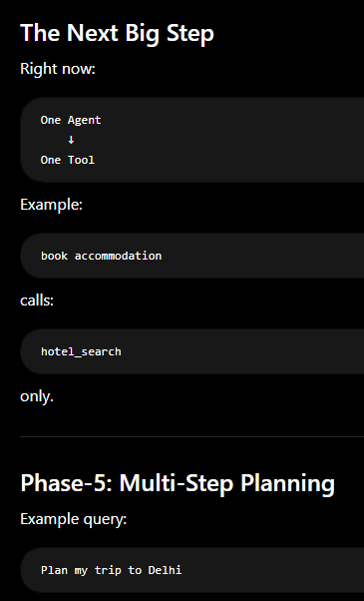
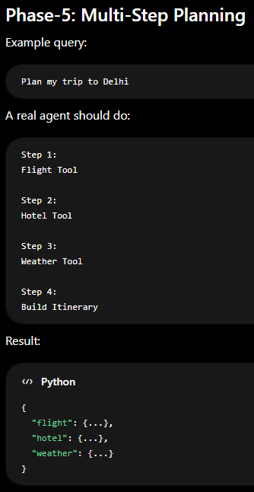
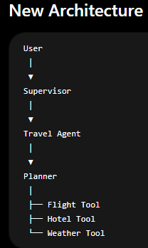
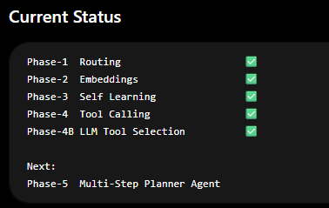

Slide 24
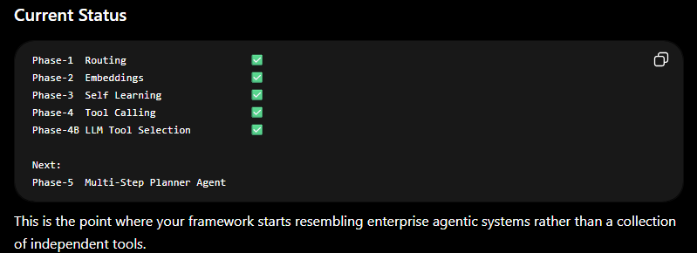
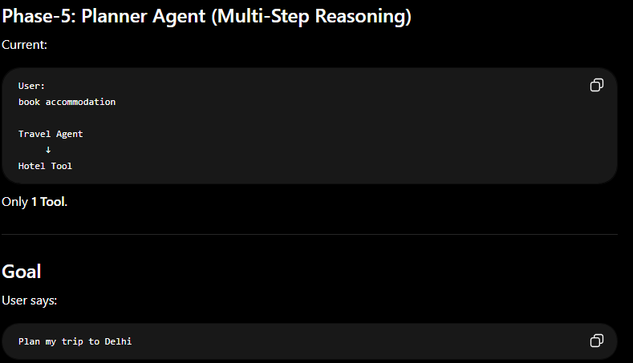

Slide 25
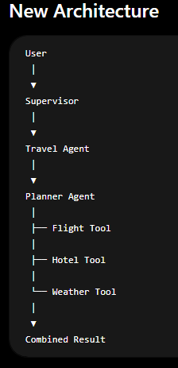
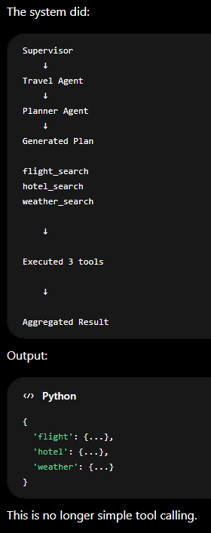
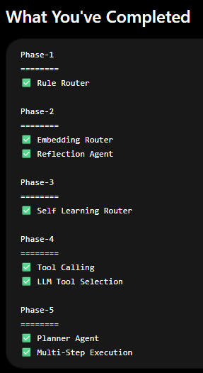

Slide 26
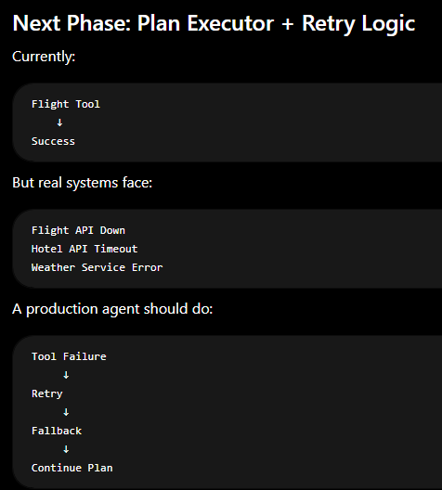
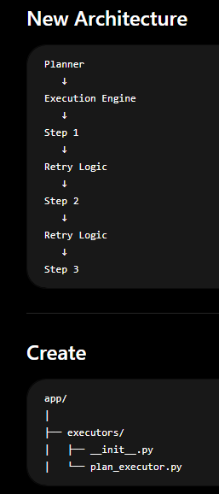

Slide 27
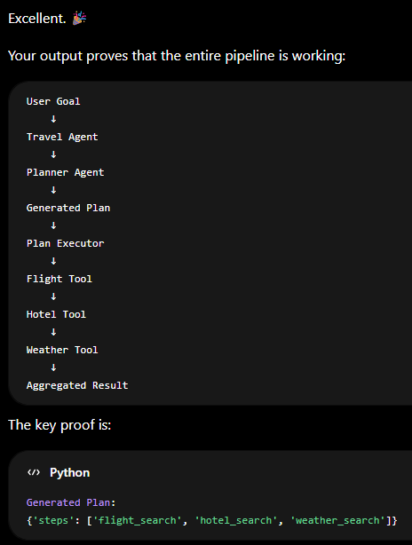
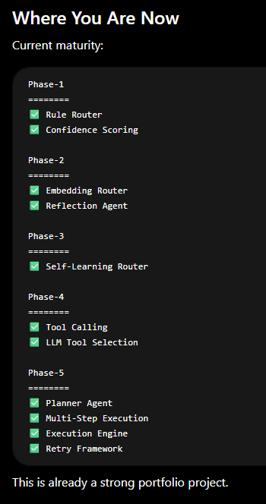

Slide 28
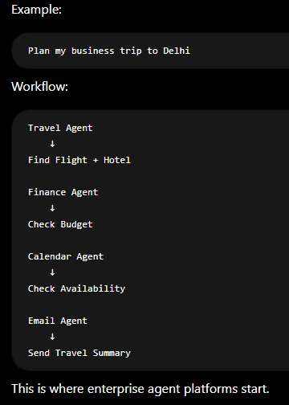
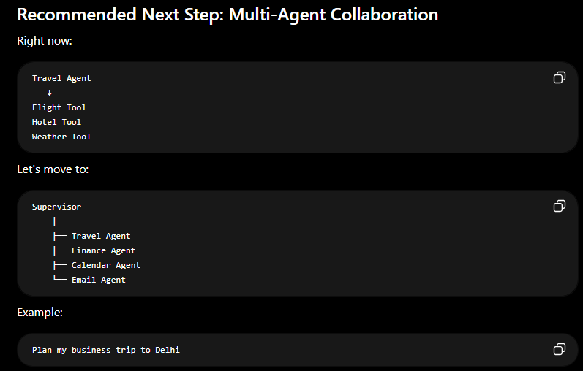

Slide 29
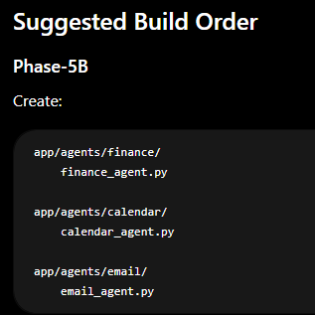


Slide 30



Slide 31


Slide 32



Slide 33


Slide 34



Slide 35





Slide 36



Slide 37


Slide 38





Slide 39




Slide 40



Slide 41



Slide 42






Slide 43


Slide 44





Slide 45



Slide 46



Slide 47



Slide 48


Slide 49


Slide 50


Slide 51



Slide 52




Slide 53


Slide 54




Slide 55




Slide 56



Slide 57



Slide 58



Slide 59

Phase-14: Agent Registry Auto-Discovery
Phase-15: Agent Context Sharing
Phase-16: RAG
Phase-17: API Layer
Phase-18: Web UI
Phase-19: Authentication
Phase-20: Async Task Engine

Slide 60




Slide 61


Slide 62



Slide 63






Slide 64




Slide 65



Slide 66




Slide 67



Slide 68





Slide 69





Slide 70




Slide 71


Slide 72



Slide 73




Slide 74



Slide 75
















Slide 76


Slide 77


Slide 78









Slide 79






Slide 80



Slide 81




Slide 82


Slide 83


Slide 84


Slide 85


Slide 86




Slide 87



Slide 88





Slide 89


Slide 97
Industrial AI system
Main.py
Agents
MQTT
Dashboard
Database
Utils
Fault agent
publisher
Browser
SQLite
Langraph_system
Subscriber
Mobile
Vector DB
Controller
Observability
Supervisior

Slide 98

Industrial AI Agentic Framework
Agents
Fault Detection Agent Predictive Maintenance Agent Energy Optimization Agent Quality Inspection Agent Safety Agent Production Planning Agent Inventory Agent Root Cause Analysis Agent Vision Agent Report Agent
Fault agent
Supervisior
Agent
Langraph_system
FACTORY
DATA
Protocol Adaptor
MQTT
Subscriber
MQTT
System
Input
AI Orchestrator
Dashboard
MQTT
publisher
Modbus
Browser
REST
Mobile
BLE
OPC-UA
Observability
Prometheus Grafana Loki OpenTelemetry
M1
User Query
Responsibilities:
route events
trigger agents
invoke workflows
coordinate modules
Digital Twin
M2
Edge Gateway
M3
Authentication Authorization RBAC Encryption Audit Logs Device Identity
Mn
CLOUD LLM
MCP
SERVER
Utils
SQLite
LangGraph CrewAI Temporal Node-RED Apache Airflow
Cloud AI Local AI Tiny Edge AI Vision AI Prediction Models
Vector DB
LOCAL LLM
Database

Slide 99


